Slide 1

BCDSS Sprint 1 Review & Sprint 2 Planning Meeting
May 16, 2016

Slide 2
BCDSS – Sprint 1 Review & Sprint 2 Planning Attendance
Office SME |  | Name |  | Attendance
Veteran Health Administration Innovations Program
Innovation Coordinator | Brian Stevenson |  | *
OSP Liaison | Edward L Wells
Product Owner | Elizabeth Wollin |  | *
OBPI Representative | Kaitlin Conron |  | *
OBPI Representative | Matthew Padula |  | *
SME | Paul J Shute
SME | VILAYPHONG SENTHEP |  | *
OBPI Representative | Karla Leal
Pro Sphere (BCDSS) | Bhupinder Pal. Singh |  | *
Pro Sphere (BCDSS) | Chiranjeevi Puttaswamy |  | *
Pro Sphere (BCDSS) | Darrell Dorman |  | *
PWS (BCDSS) | David Teague
Pro Sphere (BCDSS) | Dominic Yeh
Pro Sphere (BCDSS) | Erik Rothwell |  | *
Pro Sphere (BCDSS) | Ganesh Panneer |  | *
Pro Sphere (BCDSS) | Jeffrey Bamba |  | *
Pro Sphere (BCDSS) | Rebecca Garcia DeJesus |  | *
Pro Sphere (BCDSS) | Vasudeva Rayapati |  | *

Slide 3
BCDSS – Sprint 1 Review & Sprint 2 Planning Agenda
Objectives
Value Delivered
Challenges
Retrospective
Program Calendar
Sprint Forward

Slide 4
BCDSS – Sprint 1 Review & Sprint 2 Planning Objectives (Sprint 1)
Wireframes for Login authentication, Rater Dashboard and Search screens
Data Structures & Data base Objects for Login authentication
Refinements to Ear and Knee models – based on data verification
Required Software installation
Define Configuration and release management process
Setup third party library/API repository
Continuous Integration process setup
Developer Environment setup
Test/Pilot Environment setup

Slide 5
BCDSS – Sprint 1 Review & Sprint 2 Planning Value Delivered
Completed the creation of the Development and Test/Pilot Schemas for integrated development
Completed the physical data model for security logical data model
Role-based access control (RBAC)
Identified Configuration and Release management process
Configured Development environment setup
Configured Test/Pilot environment setup
Wireframes for Login authentication, Rater Dashboard and Search screens

Slide 6
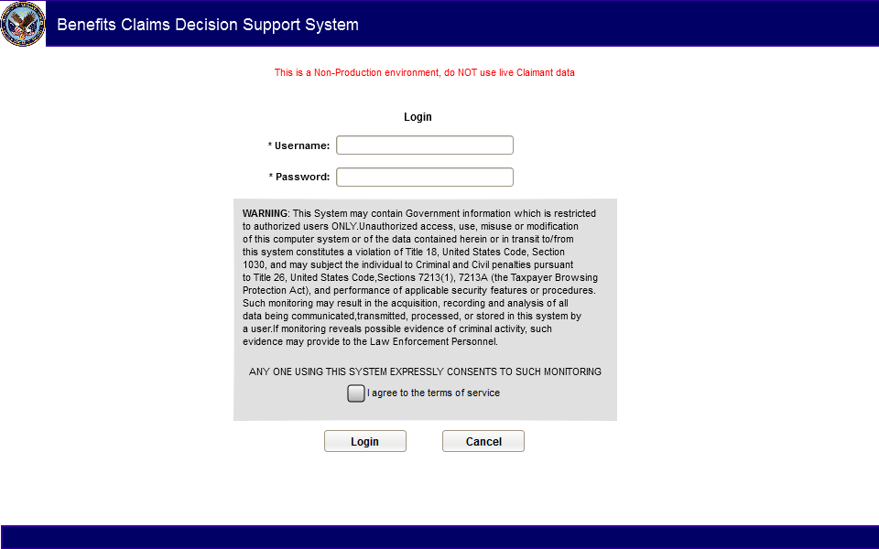
BCDSS – Sprint 1 Review & Sprint 2 Planning Value Delivered
Wireframes for Login authentication

Slide 7
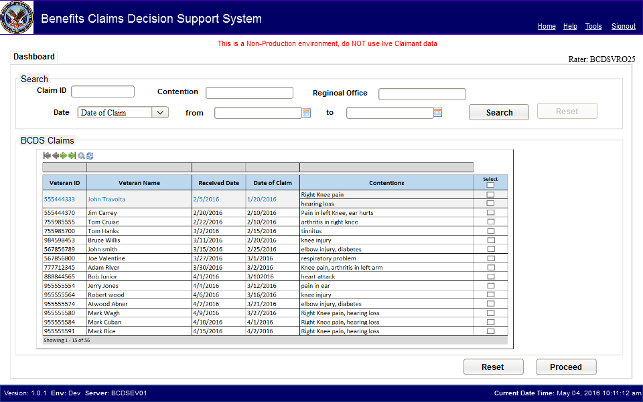
BCDSS – Sprint 1 Review & Sprint 2 Planning Value Delivered
Wireframes for Rater Dashboard

Slide 8
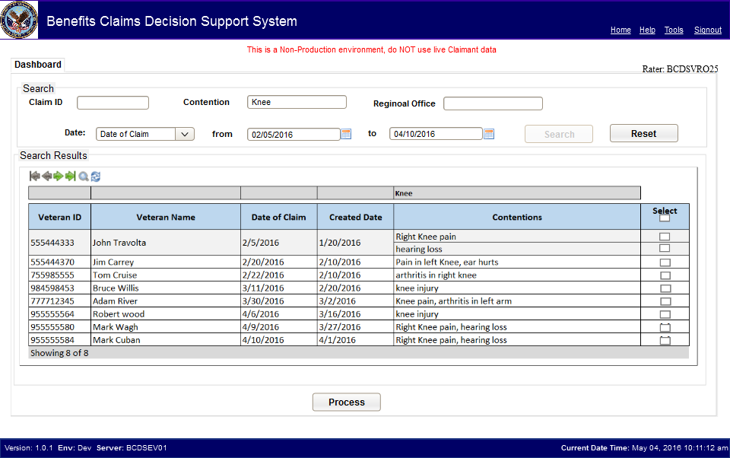
BCDSS – Sprint 1 Review & Sprint 2 Planning Value Delivered
Wireframes for Dashboard – Search Results

Slide 9
BCDSS – Sprint 1 Review & Sprint 2 Planning Challenges
Challenge
Ensuring local database instance doesn’t contain any VA data, and that it is structurally the same as the official database in the FTL environment
Mitigation
Utilize Liquibase integrated with the Maven build process for all database modifications

Slide 10
BCDSS – Sprint 1 Review & Sprint 2 Planning Metrics – Velocity

Slide 11
BCDSS – Sprint 1 Review & Sprint 2 Planning Metrics – Number of Tasks

Slide 12

BCDSS – Sprint 1 Review & Sprint 2 Planning Sprint 0 Retrospective
What Went Well
What Can Improve
Collaboration with our partners on all technical documentation
On-boarding process for new team members
Latest version of documentation has improved a lot
SDD is in very good quality
Communication has improved too
Meetings started on time – Online collaboration
Good response time for SME questions
When we can see something concrete?
Set the expectation well ahead of time
Keep continue the open communication channel

Slide 13
BCDSS – Sprint 1 Review & Sprint 2 Planning Sprint 1 Retrospective
What Went Well
What Can Improve
Collaboration between team members demonstrated the required integration is in place
Processes for Release Management were identified
Recurrent communications with the government facilitated the detection of important information
Things are moving in the right direction
Updating tasks in JIRA promptly
Metrics for upper management communication

Slide 14
BCDSS – Sprint 1 Review & Sprint 2 Planning Program Calendar
Sprint 0
(4/18 - 4/29)
Sprint 1
(5/02 - 5/13)
Sprint 2
(5/16 - 5/27)
Sprint 3
(5/30 - 6/10)
SDD, RTM
Ear & Knee Models
Database Structure & Wireframes
Collaborative Deliverable
Package and VASIC 1
4/29
5/13
5/27
6/10
6/24
5/31
Sprint 0
Completion
Sprint 1
Completion
Sprint 2
Completion
Sprint 3
Completion
Sprint 4
Completion
Legend
Completed Not Completed Future
Notes:
Add brief notes about the Sprint deliverables in this section - Elizabeth

Slide 15
BCDSS – Sprint 1 Review & Sprint 2 Planning Sprint Forward (Sprint 2)
Implement Logon/Logoff process
Create Oracle schemas for the Distributed Data Models (DDMs)
Create Logical and Physical data models for the DDMs
Generate and receive approval for Administrator Dashboard and resulting UI/UX elements
Continue to update all documentation

Slide 16
BCDSS – Sprint 1 Review & Sprint 2 Planning Questions
?

Slide 17
Thank you!

